Slide 1
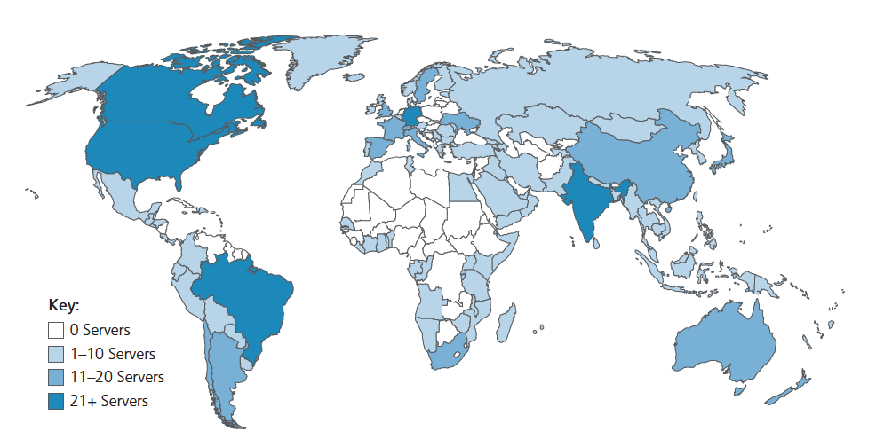
DNS: root name servers
13 logical root name “servers” worldwide each “server” replicated many times (~200 servers in US)
official, contact-of-last-resort by name servers that can not resolve names
Root name servers provide the IP addresses of the TLD servers.
incredibly important Internet function
Internet couldn’t function without it!
ICANN (Internet Corporation for Assigned Names and Numbers) manages root DNS domain

Slide 2
13 Root Name Severs
Their logical names are in the form letter.root-servers.net, where letter ranges from a to m.
There are thirteen logical root name servers because
In the original DNS specification, it specifies a maximum packet size of 512 bytes when using UDP.
All the IP addresses for root servers should fit into a single packet (using UDP) to avoid the overhead of sending multiple messages.
As each IPv4 address requires 32 bytes, having 13 servers uses 416 bytes, leaving up to 96 bytes for the remaining protocol information.
This does not mean that there are only 13 physical root servers:
Each operator uses redundant backup to provide reliable service
We have a server cluster for each of them—creating a network of hundreds of servers all around the world using a routing technique called anycast addressing.
The use of anycast addressing permits the actual number of root server instances to be much larger, and is 1,086 as of 2 July 2020. (source: Wikipedia)

Slide 3
13 Root Severs
HOSTNAME | IP ADDRESSES | OPERATOR
a.root-servers.net | 198.41.0.4, 2001:503:ba3e::2:30 | Verisign, Inc.
b.root-servers.net | 199.9.14.201, 2001:500:200::b | University of Southern California, Information Sciences Institute
c.root-servers.net | 192.33.4.12, 2001:500:2::c | Cogent Communications
d.root-servers.net | 199.7.91.13, 2001:500:2d::d | University of Maryland
e.root-servers.net | 192.203.230.10, 2001:500:a8::e | NASA (Ames Research Center)
f.root-servers.net | 192.5.5.241, 2001:500:2f::f | Internet Systems Consortium, Inc.
g.root-servers.net | 192.112.36.4, 2001:500:12::d0d | US Department of Defense (NIC)
h.root-servers.net | 198.97.190.53, 2001:500:1::53 | US Army (Research Lab)
i.root-servers.net | 192.36.148.17, 2001:7fe::53 | Netnod
j.root-servers.net | 192.58.128.30, 2001:503:c27::2:30 | Verisign, Inc.
k.root-servers.net | 193.0.14.129, 2001:7fd::1 | RIPE NCC
l.root-servers.net | 199.7.83.42, 2001:500:9f::42 | ICANN
m.root-servers.net | 202.12.27.33, 2001:dc3::35 | WIDE Project
https://www.iana.org/domains/root/servers

Slide 4
TLD & Authoritative Servers
Top-Level Domain (TLD) servers:
responsible for .com, .org, .net, .edu, .aero, .jobs, .gov, and all top-level country domains, e.g.: .cn, .uk, .fr, .ca, .jp
TLD servers provide the IP addresses for authoritative DNS servers.
Verisign: authoritative registry for .com, .net TLD
Educause: .edu TLD
Authoritative DNS servers:
organization’s own DNS server(s), providing authoritative hostname to IP mappings for organization’s named hosts
can be maintained by organization or service provider

Slide 5
Local DNS name servers
does not strictly belong to hierarchy
each ISP (residential ISP, company, university) has one
also called “default name server”
when host makes DNS query, query is sent to its local DNS server
has local cache of recent name-to-address translation pairs (but may be out of date!)
acts as proxy, forwards query into hierarchy
Notes:
The root, TLD, and authoritative DNS servers all belong to the hierarchy of DNS servers.

Slide 6
DNS: How does it work

Slide 7

DNS name resolution: iterative query
root DNS server
Example: host at engineering.nyu.edu wants IP address for gaia.cs.umass.edu
2
3
TLD DNS server
Iterative query:
contacted server replies with name of server to contact
“I don’t know this name, but ask this server”
1
4
8
5
requesting host at
engineering.nyu.edu
local DNS server
dns.nyu.edu
gaia.cs.umass.edu
7
6
authoritative DNS server
dns.umass.edu

Slide 8

DNS name resolution: recursive query
root DNS server
Example: host at engineering.nyu.edu wants IP address for gaia.cs.umass.edu
2
3
7
6
Recursive query:
puts burden of name resolution on contacted name server
heavy load at upper levels of hierarchy?
1
TLD DNS server
8
requesting host at
engineering.nyu.edu
local DNS server
dns.nyu.edu
5
4
gaia.cs.umass.edu
authoritative DNS server
dns.umass.edu
Notes:
This figure above shows a DNS query for which all the queries are recursive.
Iteration & Recursion
In practice, the query from the requesting host to the local DNS server is recursive, and the remaining queries are iterative, like the example given in the previous slide.

Slide 9
Caching, Updating DNS Records
once (any) name server learns mapping, it caches mapping
cache entries timeout (disappear) after some time (TTL)
TLD servers typically cached in local name servers
thus root name servers not often visited
cached entries may be out-of-date (best-effort name-to-address translation!)
if name host changes IP address, may not be known Internet-wide until all TTLs expire!
update/notify mechanisms proposed IETF standard
RFC 2136

Slide 10

DNS records
DNS: distributed database storing resource records (RR)
RR format: (name, value, type, ttl)
type=A
name is hostname
value is IP address
e.g., (relay1.bar.foo.com, 145.37.93.126, A)
type=CNAME
value is “canonical” (the real) name for the alias hostname name
e.g., (foo.com, relay1.bar.foo.com, CNAME)
type=MX
value is the canonical name of a mail server that has an alias hostname name
e.g., (foo.com, mail.bar.foo.com, MX)
type=NS
name is domain (e.g., foo.com)
value is hostname of authoritative name server for this domain
e.g., (foo.com, dns.foo.com, NS)
Notes:
The DNS servers (implementing the DNS distributed database) store resource records (RRs), including RRs that provide hostname-to-IP address mappings.
TTL is the time to live of the resource record; it determines when a resource should be removed from a cache.

Slide 11
DNS protocol messages
DNS query and reply messages, both have same format:
2 bytes
2 bytes
message header:
identification: 16 bit # to identifies the query, is copied into the reply message allowing the client to match received replies with sent queries
flags:
query or reply
recursion desired
recursion available
reply is authoritative
identification
flags
# questions
# answer RRs
12 bytes
# authority RRs
# additional RRs
questions (variable # of questions)
answers (variable # of RRs)
authority (variable # of RRs)
additional info (variable # of RRs)
Notes:
DNS query and reply messages are the only two kinds of DNS messages. Furthermore, both query and reply messages have the same format.

Slide 12
DNS protocol messages
DNS query and reply messages, both have same format:
2 bytes
2 bytes
identification
flags
# questions
# answer RRs
# authority RRs
# additional RRs
name, type fields for a query
questions (variable # of questions)
RRs in response to query
answers (variable # of RRs)
records for authoritative servers
authority (variable # of RRs)
additional “ helpful” info that may be used
additional info (variable # of RRs)
Notes:
The question section contains information about the query that is being made.
The answer section contains the resource records for the name that was originally queried. A reply can return multiple RRs in the answer, since a hostname can have multiple IP addresses.
The authority section contains records of other authoritative servers.

